Slide 1
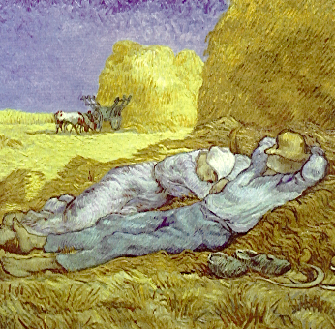
Sleep Medicine
La siesta, van Gogh

Slide 2
Wisdom of Great Physicians
Sir Robert Hutchinson
Good Lord, deliver us:
From inability to leave well alone;
From too much zeal for what is new and
contempt for what is old;

Slide 3
From putting knowledge before wisdom,
science before art, cleverness before
common sense;
Sleep Medicine, 50 Smith Street Charlestown, NSW 2290

Slide 4
From treating patients as cases; and
From making the cure of a disease more
grievous than its endurance,
Good Lord deliver us

Slide 5
Covid 19
You must wash your hands on arrival and on leaving the practice

Slide 6
Covid 19
You must wear a mask during your time here at the practice

Slide 7
Covid 19
Where possible keep 1.5 meters from any other person

Slide 8
Covid 19
Only 1 carer/relative may attend the appointment with you and only if necessary

Slide 9
Covid 19
Staff are wearing PPE (masks, shields and gowns)as appropriate,
Clinics are arranged to decrease the total number of patients on the premises
Extra surface cleaning is instituted in line with community transmission numbers

Slide 10
Sleep Medicine
Opening Hours
9am to 5.30pm
Monday to Friday

Slide 11
Sleep Medicine
You can find information in our website at
www.sleepmedicine.com.au

Slide 12
Sleep Medicine
Dr. Ambrogetti is here Tuesday and Wednesday mornings

Slide 13
Sleep Medicine
Dr. Pradeepan is here Wednesday afternoons

Slide 14
Sleep Medicine
Dr. Ray Mariasoosai is here Tuesday afternoons and some Monday & Friday mornings

Slide 15
Sleep Medicine
Dr. Alyssa Arnold is here Thursday mornings

Slide 16
Sleep Medicine
All doctors may do occasions clinics on other days/times

Slide 17
Sleep Medicine
CPAP Clinic is from 9am until 5pm Monday to Friday

Slide 18
Sleep Medicine
Our sleep scientists can be contacted for advice by telephone or attending our clinic.

Slide 19
Sleep Medicine Solutions
CPAP machines and masks may be trialed here for $100 per month (for both the machine & mask)

Slide 20
Sleep Medicine
If you have a machine with you please ask the staff at reception to have the technician download the machine ready for your visit with the doctor.

Slide 21
Oximetry
Oximetry is a test that tells us how much oxygen is in your blood

Slide 22
Oximetry
Like a (comfortable)peg you wear the oximeter on your finger overnight while you are sleeping.

Slide 23
Oximetry
The technician will explain the device and what to do at your appointment.
Oximetry cost $70 for the take home overnight test

Slide 24
Sleep Medicine
Please check in with the reception staff on arrival and again if you have not been
called within 30minutes.

Slide 25
Actigraphy
Actigraphy is a watch you wear usually for 1 week. You wear it at all times except for when showering or bathing – it cannot get wet.
It is important to keep a diary at the same time that you wear the watch. Our technician will give you a diary sheet to complete.

Slide 26
Actigraphy
The watch records your activity and may be used to monitor your sleep due to your periods of lack of movement while sleeping.
This is why it is important to keep a diary at the same time – so both the diary and watch recording may be compared.

Slide 27
Costs – for testing
Inpatient (in hospital) testing may incur an excess for you depending on your private health fund. This relates to the bed fee – not the test
The item number for a Sleep Study in hospital is 12203, the number may be different if you are having CPAP or another treatment

Slide 28
Costs to see the specialist
First visit will be $130 out of pocket ($262.30 or $361.35) upfront and all but $130 is reimbursed)
First visit will be $20 out of pocket ($152.30 or $251.35 upfront) and all but $20 is reimbursed) for pensioners and Health Care Card holders
Subsequent visits $40.00 and $10.00 for pensioners and Health Care Card Holders

Slide 29
World Sleep Day

Slide 30
World Sleep Day (WSD)
WSD is organized by the World Sleep Day Committee of the World Association of Sleep Medicine (WASM), and aims to lessen the burden of sleep problems on society through better prevention and management of sleep disorders.

Slide 31
World Sleep Day
WSD is an annual event intended to be a celebration of sleep and a call to action on important issues related to sleep.
The world sleep day is on the Friday before the March equinoxes, and therefore, the date changes each year.

Slide 32
WORLD SLEEP DAY – HOW IT BEGAN
^{The first World} Sleep Day was held on the 14th of March 2008, under the slogan ‘Sleep well, live fully awake’.
The 2009 WSD operated under the slogan “Drive alert, arrive safe” and 2010’s WSD slogan was “Sleep well, stay healthy”

Slide 33
WORLD SLEEP DAY – HOW IT BEGAN
The 2011 WSD slogan was “Sleep well, grow healthy”— with emphasis on promoting quality sleep for all ages.
The 2012 World Sleep Day slogan was “Breathe easily, sleep well” held on March 16, 2012.
The 2013 slogan was “Good sleep, healthy aging” and ^{held on March 15, 2013.}

Slide 34
WORLD SLEEP DAY – HOW IT BEGAN
The 2014 slogan was “restful sleep, easy breathing, healthy body” and the emphasis was on Sleep apnea
The 2015 slogan was “When sleep is sound, good health abounds” and the emphasis was on Insomnia
The 2016 slogan was “ Good sleep is a reachable dream” and the emphasis was on the societal burden of lack of quality sleep

Slide 35
WORLD SLEEP DAY – HOW IT BEGAN
The 2017 slogan was – Sleep Soundly, nurture life
The 2018 slogan was – Join the sleep world, Preserve your rhythms to enjoy life
The 2019 slogan was – Healthy Sleep, Healthy aging

Slide 36
World Sleep Day 2020
“Better sleep, better life, better planet”
March 13th, 2020

Slide 37
WORLD SLEEP DAY DECLARATION:
Whereas, sleepiness and sleeplessness constitute a global epidemic that threatens health and quality of life,
Whereas, much can be done to prevent and treat sleepiness and sleeplessness,

Slide 38
WORLD SLEEP DAY DECLARATION:
Whereas, professional and public awareness are the firsts steps to action,
We hereby DECLARE that the disorders of sleep are preventable and treatable medical conditions in every country of the world.

Slide 39
Good Sleep, Healthy Aging
Sleep-related respiratory disturbances and loss of quality sleep can lead to numerous health problems, such as hypertension, heart disease, stroke and diabetes.

Slide 40
Good Sleep, Healthy Aging
Failure to obtain quality sleep may lead to poor alertness, lack of attention, reduced concentration, decreased work and academic productivity, and even motor vehicle accidents.

Slide 41
Research
Research shows that we spend up to one third of our lives sleeping.
Sleep is a basic human need, much like eating and drinking, and is crucial to our overall health and well-being.

Slide 42
Research
Sleep, like exercise and nutrition, is essential for metabolic regulation in children.
There is evidence for a link between sleep duration and childhood obesity. The findings are more apparent in girls.
Sleep duration is the effect of day‐to-day variability of sleep‐wake timing on weight regulation.

Slide 43
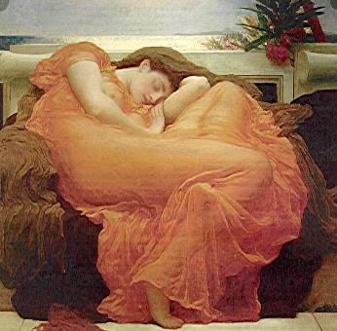
There are more than 80 sleep disorders
Flaming June , Lord Leighton

Slide 44
Obstructive Sleep Apnea
Breathing regularly during sleep is critical to maintain well-being and health.
Persistent interruption of the breathing function during sleep is called sleep apnea.

Slide 45
Obstructive Sleep Apnea
This is a common disorder that affects 4% of men and 2% of women.
Sleep apnea causes daytime sleepiness and fatigue, and may lead to conditions such as hypertension, ischemic heart disease, stroke, and diabetes.

Slide 46
Obstructive Sleep Apnea
If not properly managed, OSA can have a significant impact on a person’s health and well-being.
People who have OSA stop breathing repeatedly during sleep. OSA is caused by a blocking of the upper airway.
The collapse of the airway may be due to such factors as a large tongue, extra tissue or decreased muscle tone holding the airway open.

Slide 47
Treatment of OSA
Sleep apnea is diagnosed with polysomnography in the sleep laboratory (or in your own home).
Treatment with non-invasive positive airway (continuous positive airway pressure, or CPAP) ventilation is generally successful

Slide 48
Treatment of OSA
There is proof that successful correction of sleep apnea with non‐invasive positive airway pressure ventilation lowers blood pressure and may reduce the risk of myocardial infarction and stroke.

Slide 49
Treatment of OSA
Both adults and children should be formally investigated in sleep centers if sleep apnea is suspected
Both adult and pediatric sleep apnea is treatable and correctable; a correct and precise diagnosis is always required.

Slide 50
Treatment of OSA
Weight reduction, in most cases, is the most important treatment
and the most difficult!
The essential message is :
“Any weight reduction is of benefit”

Slide 51
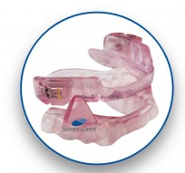
Mouthguards (Mandibular Advancing Splint)
Mouthguards move the jaw forward
and create more space in the back of the throat.
They are effective in 70 to 80 percent of cases
of moderate obstructive sleep apnea.
It is important that person can breathe freely
through the nose in order to use a mouthguard.

Slide 52
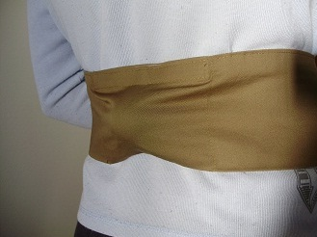
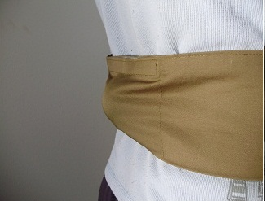
Treatment of OSA
For mild forms of sleep apnea, the application of oral devices (mouth guard) may be beneficial.
Also the use of a positional belt may be effective.

Slide 53
Memory & Learning, Anxiety & Depression
Lack of sleep or poor quality sleep is known to have a significant negative impact on our health in the long and short term.
Next day effects of poor quality sleep include a negative impact on our attention span, memory recall and learning.

Slide 54
Memory & Learning, Anxiety & Depression
Lack of sleep is related to many psychological conditions such as depression, anxiety and psychosis.
Poor quality sleep or sleep deprivation has been associated with significant health problems, such as obesity, diabetes, weakened immune systems and even some cancers.

Slide 55
Insomnia
Insomnia affects between 30-45% of the adult population
Primary insomnia (insomnia with no underlying condition) affects 1-10% of the general population, increasing up to 25% in the elderly.

Slide 56
Restless Legs Syndrome
Restless Legs Syndrome is a common disorder and occurs in between 3-10% of the population, although the number of people affected and the severity of the condition differs between countries.

Slide 57
Restless Legs Syndrome
Restless Legs Syndrome has a genetic component
More common in iron deficiency
More common with anti-depressants

Slide 58
Accidents
Lack of sleep or poor quality sleep also leaves us more vulnerable to accidents.
People who suffer from insomnia are seven times more likely to become involved in an accident causing death or serious injury than good sleepers.
Quality sleep is crucial to ensure good health and quality of life.

Slide 59
Acting out dreams (REM sleep behaviour disorder)
Some people can act out dreams, swinging their arms, punching, kicking, jumping out of bed, yelling, sometimes injuring themselves or the bed partner.

Slide 60
Acting out dreams (REM sleep behaviour disorder)
Acting out dreams is more common after the age of 50, in people on anti-depressant medications, on lithium, in patients with Parkinson disease and dementia.
It may also occur the day after binge drinking at any age.

Slide 61
Principles of Good Sleep
10 COMMANDMENTS OF SLEEP HYGIENE FOR ADULTS
Fix a bedtime and an awakening time.
If you are in the habit of taking siestas, do not exceed 45 minutes of daytime sleep.

Slide 62
Principles of Good Sleep
10 COMMANDMENTS OF SLEEP HYGIENE FOR ADULTS
Avoid excessive alcohol ingestion 4 hours before bedtime and do not smoke.
Avoid caffeine 6 hours before bedtime. This includes coffee, tea and many sodas, as well as chocolate.

Slide 63
Principles of Good Sleep
10 COMMANDMENTS OF SLEEP HYGIENE FOR ADULTS
Avoid heavy, spicy, or sugary foods 4 hours before bedtime. A light snack before bed is acceptable.
Exercise regularly, but not right before bed.

Slide 64
Principles of Good Sleep
10 COMMANDMENTS OF SLEEP HYGIENE FOR ADULTS
Use comfortable bedding.
Find a comfortable temperature setting for sleeping and keep the room well ventilated.

Slide 65
Principles of Good Sleep
10 COMMANDMENTS OF SLEEP HYGIENE FOR ADULTS
Block out all distracting noise and eliminate as much light as possible.
Reserve the bed for sleep and sex. Don't use the bed as an office, workroom or recreation room.

Slide 66
For further information please ask our staff
Still nature and sleeping woman, Matisse

Slide 73
The things we can see when we slow down Artwork by Young Cheol Lee Korean artist

Slide 78
The things we can see when we slow down Artwork by Young Cheol Lee Korean artist

Slide 79
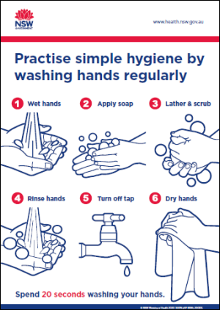

Slide 80
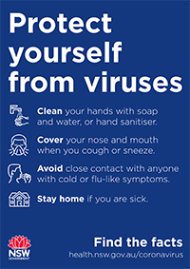

Slide 81
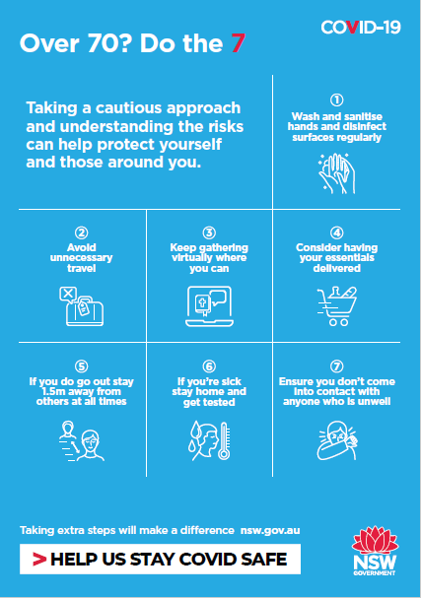

Slide 83
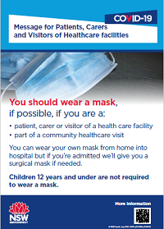

Slide 84
